Slide 1

Hyper Text Markup Language
Powered by : HK HEARTS

Slide 2

Hyper Text Markup Language
GITHUB DEPLOYMENT
Powered by : HK HEARTS

Slide 3
Hyper Text Markup Language
Links the document from other recourses
<Tags>
………
Powered by : HK HEARTS

Slide 4
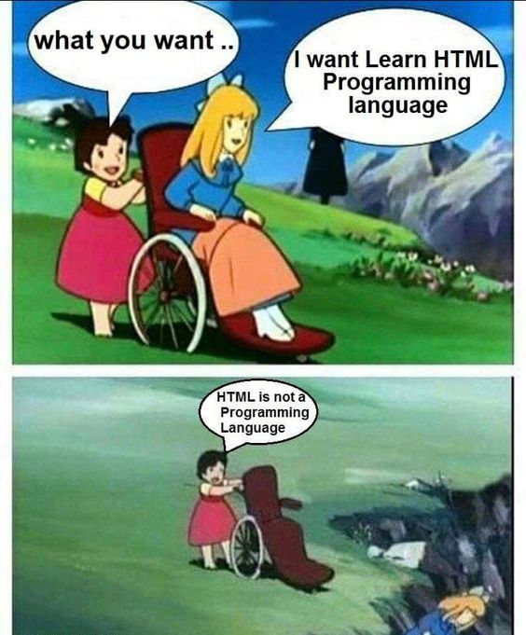
………
Powered by : HK HEARTS

Slide 5

Website
HTML : STRUCTURE CSS : STYLING
JAVA SCRIPT : LOGIC
Powered by : HK HEARTS

Slide 6
!DOCTYPE html
<!DOCTYPE html>
Document Type Declaration
DTD
Powered by : HK HEARTS

Slide 7
Comments in HTML
<!--comments go in here-->
Powered by : HK HEARTS

Slide 8
TAG
SYNTAX
USE CASE
html
<html>
<head>
</head>
<body>
</body>
</html>
<html>
….
….
….
</html>
Root element of an HTML document.
It is a container that wraps all other elements in the document.
Defining the structure of the webpage.
Powered by : HK HEARTS

Slide 9
TAG
SYNTAX
USE CASE
head
<html>
<head>
</head>
</html>
Metadata and links related to the document.
It is not displayed directly on the webpage.
Provides critical information and resources that help define the page.
<head>
….
….
….
</head>
SEO
Powered by : HK HEARTS

Slide 10
SEO
<head> <meta charset="UTF-8"> <meta name="description" content= "Folonite Training"> <meta name="keywords" content="HTML, CSS, JavaScript"> <meta name="author" content= "HK_HEARTS"> <meta name="viewport" content="width=device-width, initial-scale=1.0"> </head>
Powered by : HK HEARTS

Slide 11
TAG
SYNTAX
USE CASE
title
<html>
<head>
<title>
DOCS
</title>
</head>
</html>
<title>
….
….
….
</title>
Used to define the title of a webpage.
which is displayed in the browser's title bar or tab.
Powered by : HK HEARTS

Slide 12
TAG
SYNTAX
USE CASE
body
<html>
<head>
</head>
<body>
</body>
</html>
Represents the main content area of a webpage.
It contains all the elements that are visible to users in a browser
Such as text, images, videos, and interactive components.
<body>
….
….
….
</body>
Powered by : HK HEARTS

Slide 13
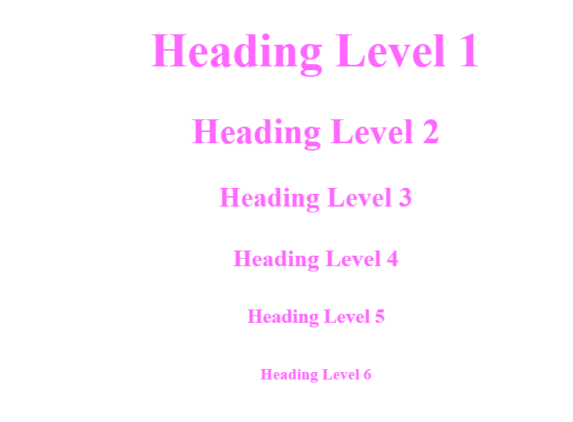
TAG
SYNTAX
USE CASE
headings
<h1>
….
….
….
</h1>
…
h6
Used to define headings on a webpage.
These tags help structure content by providing a hierarchy of headings
The most important (h1) to the least important (h6).
Powered by : HK HEARTS

Slide 14

TAG
SYNTAX
USE CASE
horizontalrule
Self closing tag
These tags help structure content by providing a hierarchy of headings
The most important (h1) to the least important (h6).
<p>
<hr>
</p>
<hr>
Powered by : HK HEARTS

Slide 15
Self Closing Tags
<Tag_name />
Empty elements : <hr />, <br />, <img />
Powered by : HK HEARTS

Slide 16
TAG
SYNTAX
USE CASE
image
Self closing tag
These tags help structure content by providing a hierarchy of headings
The most important (h1) to the least important (h6).
<img src=“” alt=“”>
<img>
Attributes
src => Source
alt => Alternative
Powered by : HK HEARTS

Slide 17
Attributes
attribute=“ ”
src, href, style, rel, place-holder .. etc
Powered by : HK HEARTS

Slide 18
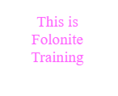
TAG
SYNTAX
USE CASE
break
<p> This is
<br> Folonite
<br>
Training
</p>
Self closing tag
These tags help structure content by providing a hierarchy of headings
The most important (h1) to the least important (h6).
<br>
Powered by : HK HEARTS

Slide 19
TAG
SYNTAX
USE CASE
paragraph
Used to define a paragraph of text.
It is one of the most commonly used tags in HTML
Serves as a container for text content, separating it into distinct blocks.
<p>
…
…
</p>
<html>
<p>
This is the Folonite Basic Industrial Training Program
</p>
</html>
Powered by : HK HEARTS

Slide 20
Lorem epsum
Lorem{word count}
Lorem10, lorem100, etc..
Powered by : HK HEARTS

Slide 21

TAG
SYNTAX
USE CASE
italic
<html>
<p>
<i> Folonite </i> Basic Industrial Training Program
</p>
</html>
Used to indicate text that should be displayed in an italicized style.
Text that has a semantic meaning.
Such as foreign words, or technical terms.
<i>
…
…
</i>
Powered by : HK HEARTS

Slide 22

TAG
SYNTAX
USE CASE
bold
<html>
<p>
<b> Folonite </b> Basic Industrial Training Program
</p>
</html>
Used to display text in a bold font weight.
It is primarily intended for stylistic purposes
Such as drawing attention to certain words in the text.
<b>
…
…
</b>
Powered by : HK HEARTS

Slide 23
Semantic Tag
<em>, <strong>
Emphasize or impressed the pronunciation during the screen reader reads the webpage.
Powered by : HK HEARTS

Slide 24
TAG
SYNTAX
USE CASE
emphasize
<html>
<p>
<em> Folonite </em> Basic Industrial Training Program
</p>
</html>
Used to emphasize text, typically rendering it in italic style by default.
This tag conveys semantic meaning.
Indicating that the content enclosed should be stressed or highlighted with emphasis.
<em>
…
…
</em>
Powered by : HK HEARTS

Slide 25
TAG
SYNTAX
USE CASE
strong
<html>
<p>
<strong>
Folonite
</strong>
Basic Industrial Training Program
</p>
</html>
Used to indicate text of great importance, seriousness, or urgency.
By default, it renders the text in bold font style
But its primary purpose is semantic, not visual.
<strong>
…
…
</strong>
Powered by : HK HEARTS

Slide 26

TAG
SYNTAX
USE CASE
mark
<html>
<p>
<mark>
Folonite
</mark>
Basic Industrial Training Program
</p>
</html>
Used to highlight or mark text that is of special relevance or importance within the context of the document.
Default : Yellow background and Black text.
<mark>
…
…
</mark>
Powered by : HK HEARTS

Slide 27
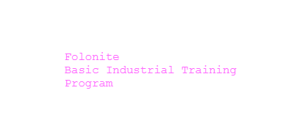
TAG
SYNTAX
USE CASE
pre-define
<html>
<p>
<pre>
Folonite
Basic Industrial Training Program
</pre>
</p>
</html>
Used to define preformatted text.
Text inside this tag is displayed exactly as it is written in the HTML document, preserving spaces, line breaks, and indentation.
<pre>
…
…
</pre>
Powered by : HK HEARTS

Slide 28
TAG
SYNTAX
USE CASE
anchor
Used to create hyperlinks.
Enabling users to navigate to other webpages, sections of the same page, files, email addresses, or external resources.
<a href=“URL”>
…
…
</a>
<html>
<p>
<a href=https://folonite.in/>
Folonite
</a>
</html>
Powered by : HK HEARTS

Slide 29

TAG
SYNTAX
USE CASE
delete
Used to indicate text that has been deleted or removed from a document.
Browsers display text inside the tag with a strikethrough to visually represent the deletion.
<del>
…
…
</del>
<html>
<del>
Deleted
</del>
</html>
Powered by : HK HEARTS

Slide 30
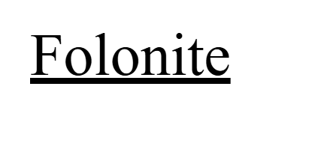
TAG
SYNTAX
USE CASE
insert
Used to indicate text that has been inserted or added to a document.
Browsers display text inside the with an underline.
<ins>
…
…
</ins>
<html>
<ins>
Folonite
</ins>
</html>
Powered by : HK HEARTS

Slide 31
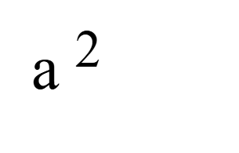
TAG
SYNTAX
USE CASE
sup(super)
Used to define superscript text.
Which is text that is displayed slightly above the normal line of text and in a smaller font size
<sup>
…
…
</sup>
<html>
a
<sup>
2
</sup>
</html>
Powered by : HK HEARTS

Slide 32
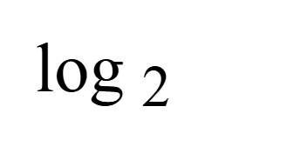
TAG
SYNTAX
USE CASE
sub(base)
Used to define subscript text.
This is text displayed slightly below the normal line of text and in a smaller font size.
<sub>
…
…
</sub>
<html>
log
<sub>
2
</sub>
</html>
Powered by : HK HEARTS

Slide 33
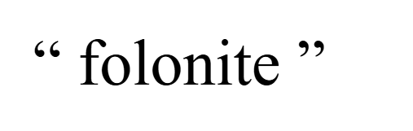
TAG
SYNTAX
USE CASE
q(quotation)
Used to define a short inline quotation.
Wrapped quotation marks around it.
<q>
…
…
</q>
<html>
<q>
folonite
</q>
</html>
Powered by : HK HEARTS

Slide 34
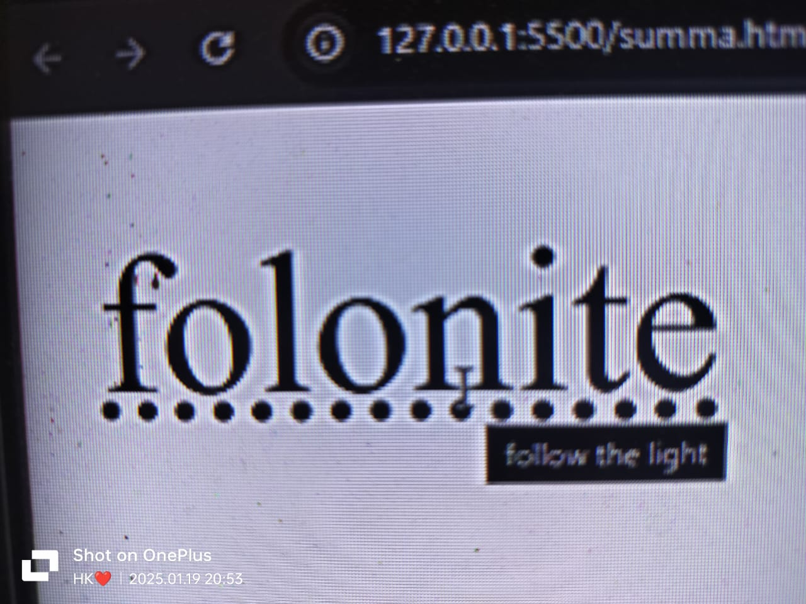
TAG
SYNTAX
USE CASE
abbr(abbrevation)
<abbr title=“”>
…
…
</abbr>
Used to define an abbreviation or acronym.
Providing additional information about its meaning or full form.
<html>
<abbr title=“follow the light”>
folonite
</abbr>
</html>
Powered by : HK HEARTS

Slide 35
TAG
SYNTAX
USE CASE
link
<link rel=“” href=“”>
…
…
</link>
Used to define a relationship between an HTML document and an external resource.
It is most commonly used to link external stylesheets to a webpage but can also be used for other relationships.
<html>
<link href=“style.css”
</link>
</html>
Powered by : HK HEARTS

Slide 36
TAG
SYNTAX
USE CASE
table
<html>
<table>
<tr>
<th>Header 1</th> <th>Header 2</th>
</tr>
<tr>
<td>Data 1</td> <td>Data 2</td>
</tr>
</table>
</html>
<table>
<tr>
<td>…</td>
</tr>
</table>
Tag is used to create a table for displaying data in rows and columns.
It provides a structured way to organize content, making it ideal for tabular data like spreadsheets, schedules, or comparison charts.
Powered by : HK HEARTS

Slide 37
Table
<th> ,<tr> & <td>
<tr> Defines the row in the table.
<td> Defines the cells that hold data.
<th> Defines the header in the text.
Powered by : HK HEARTS

Slide 38
Border
border, border collapse
border: solid;
border-collapse: collapse;
Powered by : HK HEARTS

Slide 39
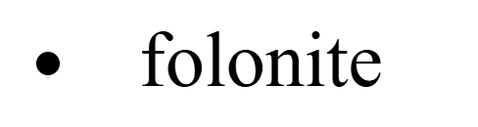
TAG
SYNTAX
USE CASE
list
<li>
…
…
</li>
Used to define a list item within a list.
Conjucation of ul, ol tags.
<html>
<li>
folonite
</li>
</html>
Powered by : HK HEARTS

Slide 40
List elements
<ul> ,<ol> & <li>
<ul> Unordered List.
<ol> Ordered List.
<li> List elements.
Powered by : HK HEARTS

Slide 41
TAG
SYNTAX
USE CASE
div(block-element)
<div>
…
…
</div>
Tag is a block-level container used to group together content for structuring and styling purposes.
It is a generic container that holds other elements
<html>
<div>
<tags>
contents
</div>
</html>
Powered by : HK HEARTS

Slide 42
TAG
SYNTAX
USE CASE
span(inline-element)
<span>
…
…
</span>
Tag is a generic inline container used to group text or other inline elements.
Does not introduce a line break.
<html>
<span>
<tags>
contents
</span>
</html>
Powered by : HK HEARTS

Slide 43
TAG
SYNTAX
USE CASE
iframe
<iframe src=“”>
…
…
</iframe>
used to embed another HTML document within the current document.
It allows you to include external content such as webpages, videos, or interactive applications inside a parent page.
<html>
<iframe src=“”>
</iframe>
</html>
Powered by : HK HEARTS

Slide 44
TAG
SYNTAX
USE CASE
forms
<forms>
…
…
</forms>
Used to collect user input and send it to a server for processing.
Forms can include input fields, buttons, and other elements to enable users to enter and submit data.
<html>
<label></label>
<input></input>
<button></button>
</html>
Powered by : HK HEARTS

Slide 45
TAG
SYNTAX
USE CASE
label
<label>
…
…
</label>
Used to embed another HTML document within the current document.
It allows you to include external content such as webpages, videos, or interactive applications inside a parent page.
<html>
<label>Name: </label>
</html>
Powered by : HK HEARTS

Slide 46
TAG
SYNTAX
USE CASE
input
<input type=“”>
…
…
</input>
Used to create interactive form elements that allow users to enter data or interact with a form.
Various input types like text, password, checkbox, radio, file upload, and more.
<html>
<input type=“”>
>/input>
</html>
Powered by : HK HEARTS

Slide 47
Input attributes
type, value, placeholder, required,
Value Preset
Placeholder Overriddenable
Required Must.
Type How to look
Radio button + name attribute
Powered by : HK HEARTS

Slide 48
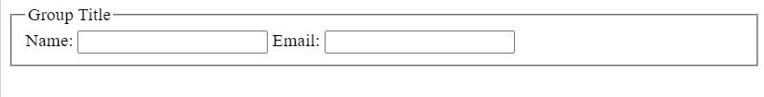
TAG
SYNTAX
USE CASE
fieldset, legend
<fieldset>
<legend>
Group Title
</legend>
<label for="name">
Name:</label>
<input type="text" id="name" name="name">
<label for="email">Email:
</label>
<input type="email" id="email" name="email">
</fieldset>
<fieldset>
<legend>
..
</legend>
…
</fieldset>
used to group related elements within a form, providing a visual and semantic grouping for better organization and accessibility.
It is commonly used with the <legend> tag which acts as a title for the grouped content.
Powered by : HK HEARTS

Slide 49

BELIEVE IN YOURSELF
Powered by : HK HEARTS

